Slide 1



Echo Hire
Home
Service
About Us
Contact
Echo
FRANK XAVIO
Hire

Slide 2

Echo Hire
Home
Service
About Us
Contact
About Us
A team of tech enthusiasts aiming to upgrade the interview knowledgreof the youth and then help them prepare tailored to individual needs

Slide 3
Echo Hire
Home
Service
About Us
Contact
Meet Our Team
VISHAL PRABHU
FRANK XAVIO
RISHI RATHESH
HARI PADMESH

Slide 4

Echo Hire
Home
Service
About Us
Contact
Our Vision
The project aims to provide a smooth and confident interview experience for every job seeker out there
Our Inspiration:
A winning effort starts with preparation

Slide 5
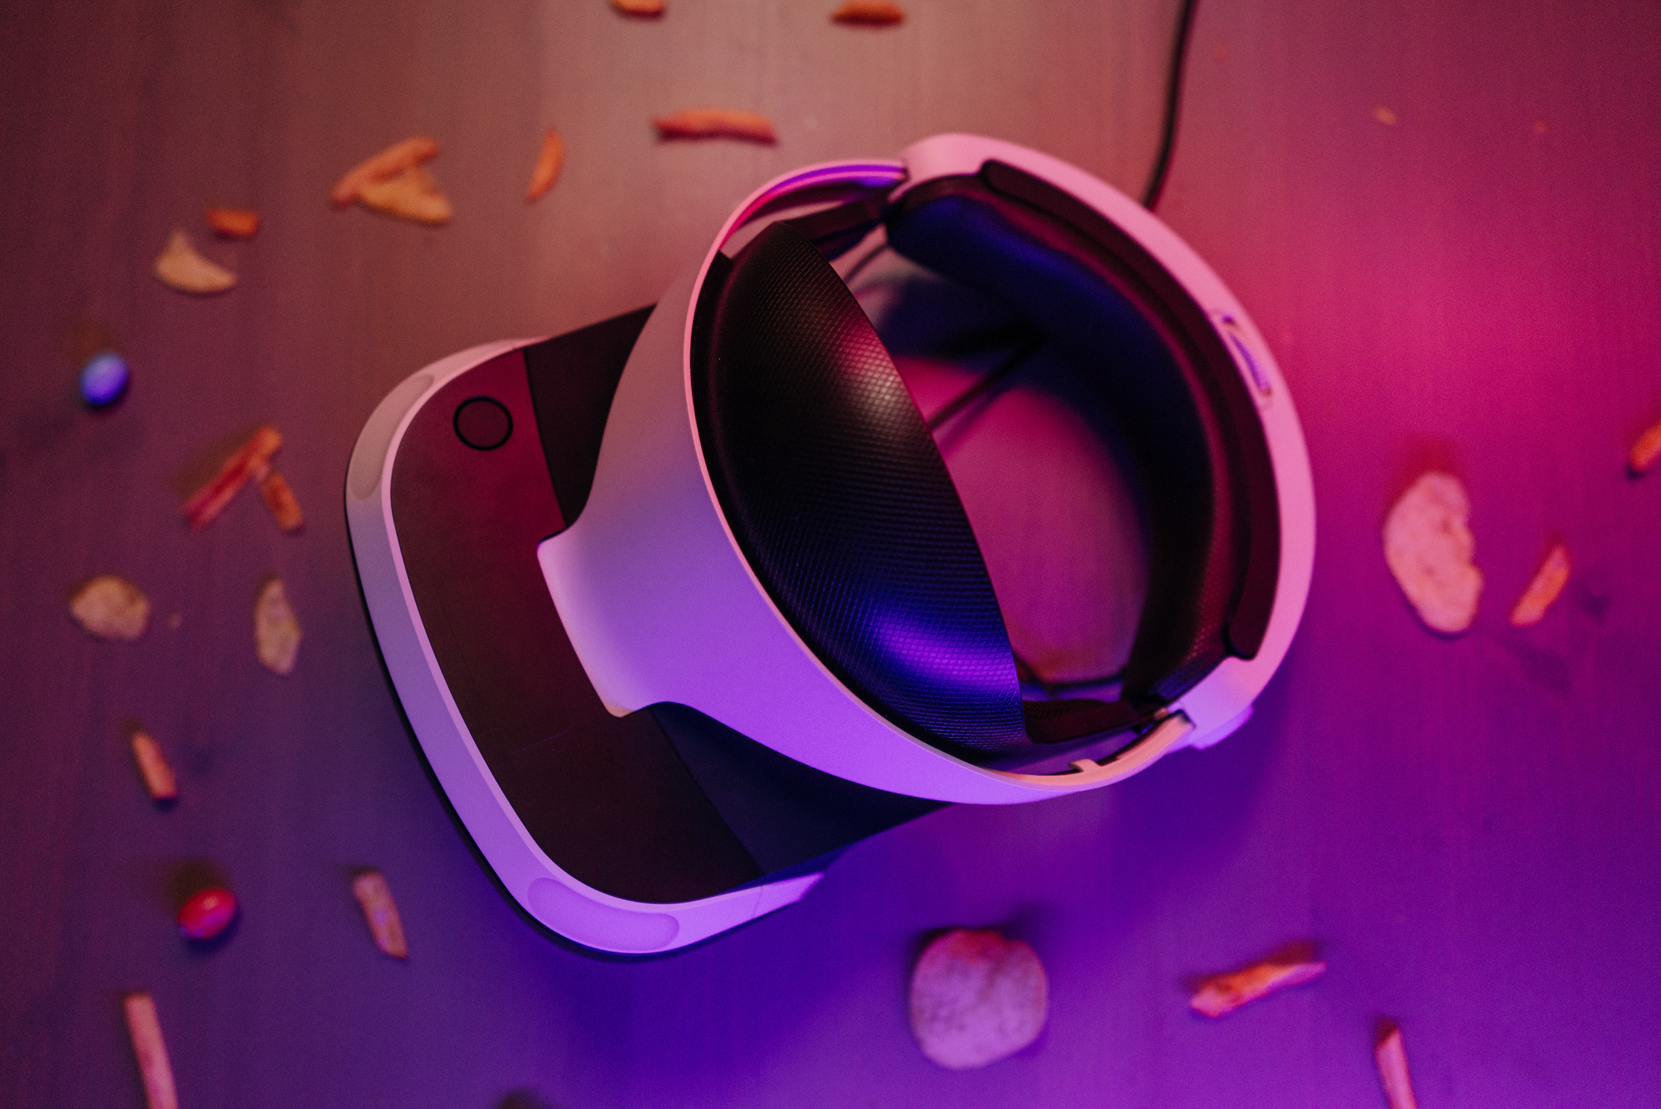
Echo Hire
Home
Service
About Us
Contact
Our Project
Echo Hire
It is a Next.js based application which integrates AI speech tools like Vapi to innvolve the user into actual interview like environment
01
Helps the user with self paced prep
02
It focuses on the personal development of the individual helping him/her to prepare for specific company leveled interviews
Prepares company based interviews with customisable filters
The voice asssitant analyses the user and provides a detailed report about the interview and comments on various aspects
03
The data analysed prompts self improvement

Slide 6

Echo Hire
Home
Service
About Us
Contact
Tech Stack
NextJs 15
Tailwind Css
ShadCn
React Hook Forms
TanstackQuery
Zustand
Supbase
OpenRouterAi
Vapi
Axios

Slide 7

Echo Hire
Home
Service
About Us
Contact
Thank You

